Slide 1
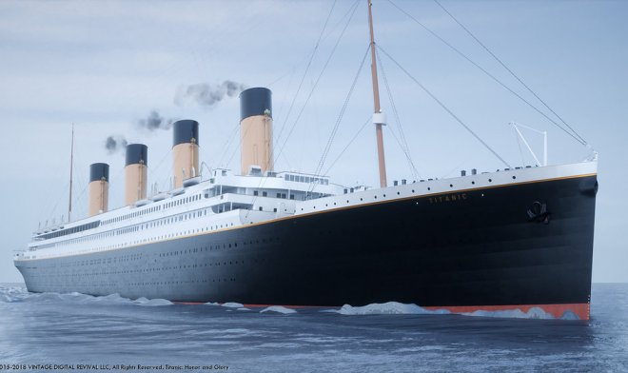
Titanic Survival prediction
A try to evaluate if a person survives or not taking into consideration personal data and data from travelling documents.

Slide 2
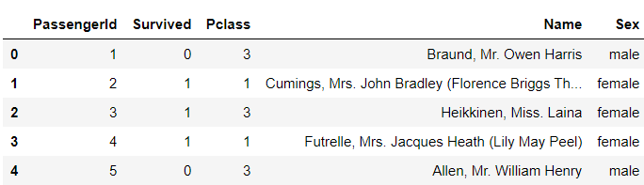
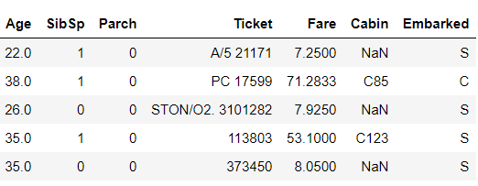
What we have as an input data:
Let’s take a look at a sample data

Slide 3
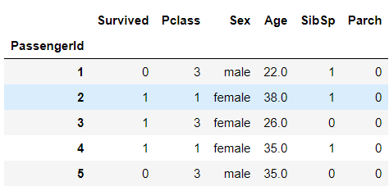
Remove the columns:
Name – passengers’ names
Ticket – passengers’ ticket number
Fare – the price paid for the ticket
Cabin – the number of the cabin
Embarked – the port, where the passenger embarked the ship.
Now we have only the columns that can influence the result.

Slide 4
The brief analysis shows that:
Survived young and middle-aged people, not children or the old ones.
Survived more first class passengers, then 2nd class and then 3rd.
Survived more people who had some (1-2) family members onboard.
Not the ones who travelled alone or with a big family.
The distribution in the sex of the survivors is shown on the next slide.

Slide 5
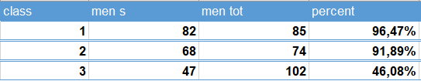
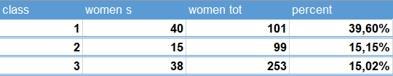
Men’s survival rate
Women’s survival rate
Barely this information gives us a clear view that the features that influenced the possibility of survival were mostly the sex and the class where a passenger travelled.

Slide 6
The performed analysis showed that women and children were not the ones to get places in the boats.
It is clear that the strength, the quickness and the possibility to make the way using his fists played the first role.
Also, as some survivors remember, the fact that the 3rd class passengers were blocked from getting to the life boats is confirmed by a big difference between the survivors of that class and the first two.
The dataset was provided by Kaggle.

